Slide 1
The Importance of Balanced Nutrition!
Andrea Griffith
Community Nutritionist

Slide 2
FOOD GROUPS, NUTRIENTS AND FUNCTIONS
FOOD GROUPS | NUTRIENT | FUNCTION
FOODS FROM ANIMALS Meat, poultry, fish, eggs, milk | PROTEIN FAT | Strong bones and teeth Energy, warmth, protects the organs
STAPLES: rice, pasta, ground provisions, corn, bread, biscuits, etc. | CARBOHYDRATE | Energy, allows protein to do its main job
LEGUMES Lentils, chick peas, pigeon peas, kidney beans, etc. | PROTEIN CARBOHYDRATE VITAMINS, MINERALS | Strong bones and teeth Energy, allows protein to do its main job Strengthen the immune system
FRUITS Apples, oranges, mangoes, berries, etc. | VITAMINS & MINERALS | Strengthen the immune system Wound healing and cell repair
VEGETABLES Carrots, cabbage, lettuce, broccoli, okras, etc. | VITAMINS & MINERALS | Strengthen the immune system Wound healing and cell repair
FATS AND OILS: oils, butter, avocado, coconut, seeds, nuts | FAT | Energy, warmth, protects the organs

Slide 3
UNDERSTANDING THE PLATE METHOD
SERVINGS PER MEAL
CARBOHYDRATE: 2 -3
PROTEIN: 1 -2
FAT: 1

Slide 4
LIFESTYLE BEHAVIOURS AND DISEASE RELATIONSHIP
DIABETES, HYPERTENSION, CANCERS, HEART DISEASE, STROKE, RENAL DISEASE, OBESITY, CHRONIC FATIGUE
POOR NUTRITION
EXCESSIVE: SUGAR, SALT, GREASE, FAT, PROCESSED FOODS, BAKED GOODS, SALT-BASED FOOD FLAVOURINGS
LACK OF EXERCISE &
PHYSICAL ACTIVITY
LACK OF RELAXATION, REST & SLEEP
Smoking
Excessive alcohol intake
Stress
Un-forgiveness

Slide 5
Your Health is your Best Investment
Enhances quality of life; breathe better, energetic, stronger, fitter, less sick time / days
Age better – better outlook on life and towards the future
Reduces the risk of NCDs, cancers and other illnesses and conditions associated with the aging process
Reduces medical expenses
Live longer and healthier

Slide 6
HIGH CHOLESTEROL
INCREASED RISK OF
HEART ATTACK
STROKE
BLOOD CLOTS
POOR CIRCULATION
DIABETES & HYPERTENSION
INCREASED RISK OF
HEART ATTACK / STROKE
BLOOD CLOTS
CATARACT / GLAUCOMA / BLINDNESS
KIDNEY DAMAGE / DISEASE → FAILURE →DIALYSIS →
TRANSPLANT →PREMATURE DEATH
POOR CIRCULATION
NERVE DAMAGE
AMPUTATION → MINOR → MAJOR

Slide 7
Excessive Sugar in the Diet
Starch = sugar when digested
Alters mood as it has an impact of dopamine – but more and more sugar is needed for the feel-good-factor
Teeth
Skin – causes premature wrinkles and sagging
Liver – Non-alcoholic Fatty Liver Disease
Hardening of the arteries
Damages the pancreas increasing risk of type 2 DM
Affects circulation
Reduces ability to have an erection
Increase risk of heart attack and stroke
Increase risk of amputation

Slide 8
ADULTS MUST TAKE RESPONSIBILITY
→ CHILDREN DO WHAT ADULTS DO
SET GOOD EATING AND EXERCISE HABITS → CHILDREN EAT WHAT THEY ARE ACCUMTOMED TO
FRUITS AND VEGETABLES → IF NOT BOTH, USE VEGETABLES
USE GROUND PROVISIONS
USE A VARIETY OF PEAS AND BEANS DAILY
DISCUSS CIRCUMSTANCES AS A FAMILY SO CHILDREN ARE NOT MISLED OR MISGUIDED
CREATE HEALTHY FAMILY ACTIVITIES – SPORTS DAY, BEACH DAYS, SCRABBLE, TREASURE HUNTS
PROCESSED FOODS? (HOTDOGS, NUGGETS, BURGERS, CORNCURLS, SWEET BISCUITS, SWEET DRINKS)
High levels of sodium, saturated fat, sugar
Lots of preservatives & carcinogens
Lots of imitation colouring and dye
PREVALENT IN THE YOUTH: HUNGER, MALNUTRITION (UNDER / OVER), HIGH CHOLESTEROL, HYPERTENSION, DIABETES, ETC.
harmful to health, avoid as much as possible

Slide 9
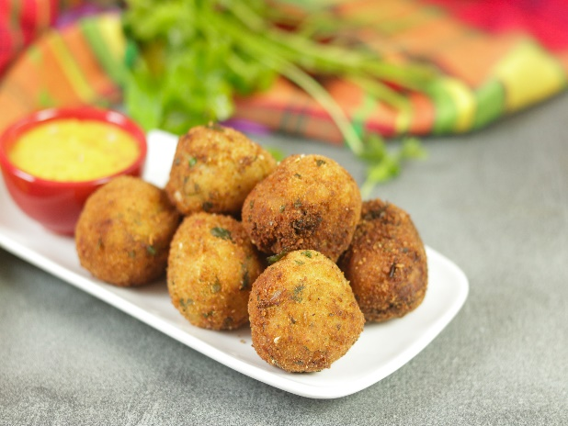
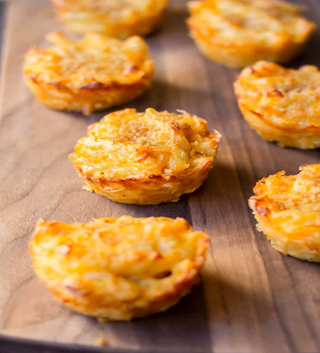
Healthy and Economical Ideas
Sandwiches: use left over meat, poultry, fish
Add lettuce, tomatoes
Cheese or tuna paste → add grated carrot if possible
Cook peas in advance and make into a paste (hummus), patties / balls, stews
Add peas to meat dishes to stretch the meat yet enhance the nutritive value
Breadfruit: very versatile food and loaded with nutrients. A superfood in his own right
Crushed, balls, chips, casserole
cook ahead of time and freeze to make chips or cheesy balls.
Pumpkin Mac and Cheese → bake in muffin pan and freeze for later, kids love these
Whole wheat flour / oat /barley flour bakes, muffins, pancakes, fritters – keep a batch of batter
in the fridge for a quick and nutritious meal
Bakes, muffins, pancakes, potted bakes (knead very firm and cook in a covered pan without oil
Rock Buns: (fruity, coconut)a quick and easy snack that freezes well,
Reduce sugar by adding fruits, this also increases fibre
Muffins: add banana or grated pumpkin for taste and flavor, freezes well
Calcium rich beverages: milk blended with banana, overripe plantain, mango,

Slide 10
Lifestyle Choices AND Disease Outcome
SWEET DRINK $3.50 | CHILLED WATER FREE HOMEMADE LEMONADE $ 0.25
LARGE SWEET BISCUITS $2.50 | 1 BANANA $1.00
TOTAL $6.00 | TOTAL $1.25
NUTRIENTS: SATURATED FATS, SUGAR, SODIUM | NUTRIENTS: VITAMIN C, FIBRE, VITAMINS, MINERALS
BE WISE IN SPENDING
IF YOU ARE TOO BROKE TO BUY FOOD, FRUITS OR VEGETABLES
YOU ARE DEFINITELY TOO BROKE TO BUY JUNK OR FAST FOOD

Slide 11
, BUT
Actions
=
consequence

Slide 12
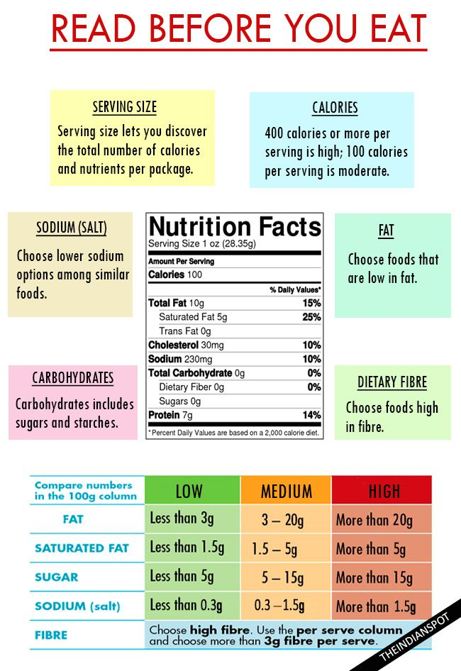
Prepare Healthier Meals by Understanding the Nutrition Facts Label
A specific amount of food that contains a specific amount of calories.

Slide 13
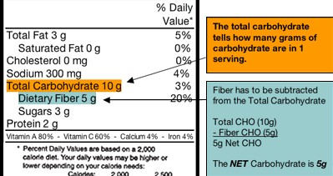
Understanding Total Carbohydrates in the Nutrition Facts Labels
Total CHO 10 g
Fibre 5 g
Sugar 3 g
The other 2 g is starch
Starch becomes sugar in the body,
it will contribute to the elevation of blood glucose / sugar
Diabetics need to be aware!

Slide 14
Be DEDICATED to
PROPER NUTRITION AND WELLNESS
They provide RESILENCE
AGAINST SICKNESS AND DISEASE
& ENSURES EXCELLENCE
IN ALL YOUR CHOICES
QUESTIONS

